Slide 1
ATP Tennis Betting Market Efficiency
Ilia Lomasov
ICEF, year 4
Scientific supervisor: Vladimir Solokov, PhD
Moscow, 2022

Slide 2
Structure
Introduction
Motivation
Theoretical framework & model
Data Sources
Results
Robustness checks
Conclusion
Practical implications
Appendix

Slide 3
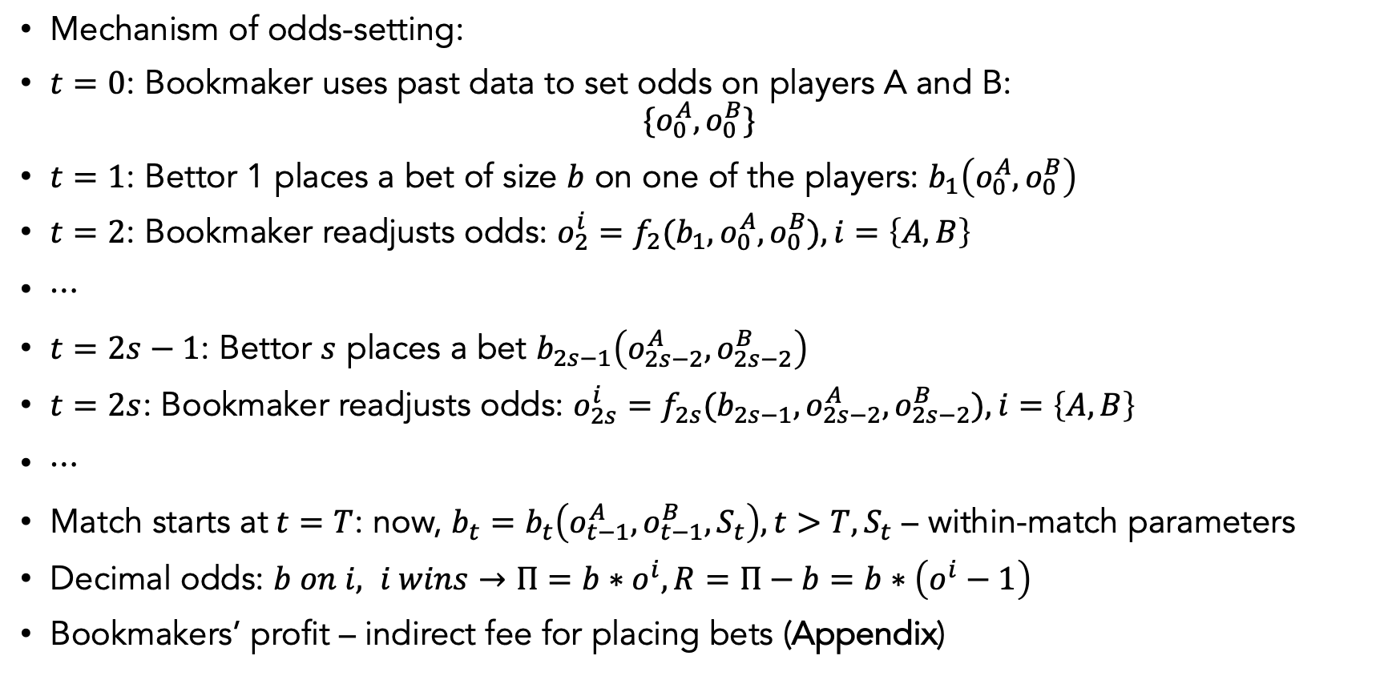
Introduction (I)
Mechanism of odds-setting:
$t=0$: Bookmaker uses past data to set odds on players A and B: $\{o_{0}^{A},o_{0}^{B}\}$
$t=1$: Bettor 1 places a bet of size $b$ on one of the players: $b_{1}\left(o_{0}^{A},o_{0}^{B}\right)$
$t=2$: Bookmaker readjusts odds: $o_{2}^{i}=f_{2}(b_{1},o_{0}^{A},o_{0}^{B}), i=\left\{A,B\right\}$
$⋯$
$t=2s−1$: Bettor $s$ places a bet $b_{2s−1}\left(o_{2s−2}^{A},o_{2s−2}^{B}\right)$
$t=2s$: Bookmaker readjusts odds: $o_{2s}^{i}=f_{2s}(b_{2s−1},o_{2s−2}^{A},o_{2s−2}^{B}), i=\left\{A,B\right\}$
$⋯$
Match starts at $t=T$: now, ${b_{t}=b}_{t}\left(o_{t−1}^{A},o_{t−1}^{B},S_{t}\right), t>T, S_{t}$ – within-match parameters
Decimal odds: $b on i, i wins→Π=b∗o^{i}, R=Π−b=b∗\left(o^{i}−1\right)$
Bookmakers’ profit – indirect fee for placing bets (Appendix)

Slide 4
Motivation
Idea:
Empirically search for for parameters that define bettors’ choice of one player or another
Test whether the model is applicable to out-of-sample data and hence could be used to form betting strategies
Main Additions:
Side steps from arbitrage/efficiency in terms of profitability of odds (literature track 1 e.g., Sauer, 2005) and fundamentals-based match result forecasting (literature track 2 e.g., Easton & Uylangco, 2010)
Contribution:
This study:
contributes to the papers on analysis of sports [ATP tennis] bettors’ decision-making
serves as a basis for further studies along both track 1 and track 2

Slide 5
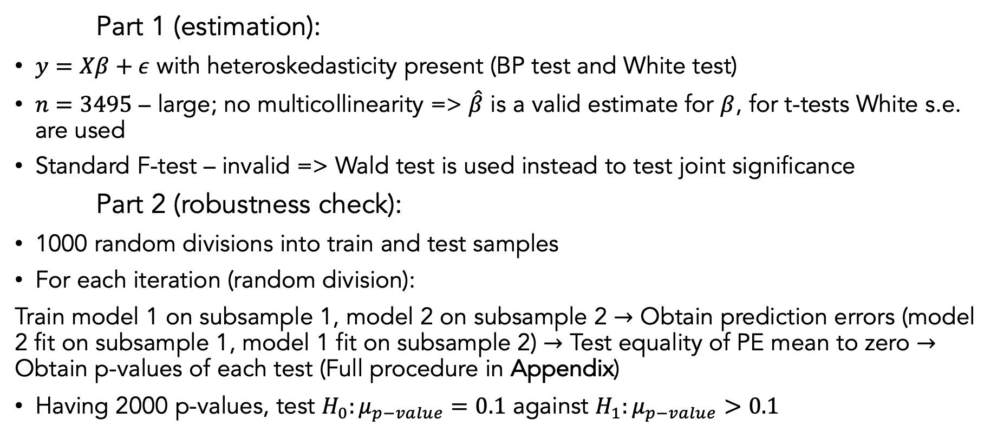
Theoretical Framework & Model
$\text{Part}\text{ 1 (}\text{estimation}\text{):}$
$y=Xβ+ε$ with heteroskedasticity present (BP test and White test)
$n=3495$ – large; no multicollinearity => $\hat{β}$ is a valid estimate for $β$, for t-tests White s.e. are used
Standard F-test – invalid => Wald test is used instead to test joint significance
Part 2 (robustness check):
1000 random divisions into train and test samples
For each iteration (random division):
Train model 1 on subsample 1, model 2 on subsample 2 $→$ Obtain prediction errors (model 2 fit on subsample 1, model 1 fit on subsample 2) $→$ Test equality of PE mean to zero $→$ Obtain p-values of each test (Full procedure in Appendix)
Having 2000 p-values, test $H_{0}:μ_{p−value}=0.1$ against $H_{1}:μ_{p−value}>0.1$

Slide 6
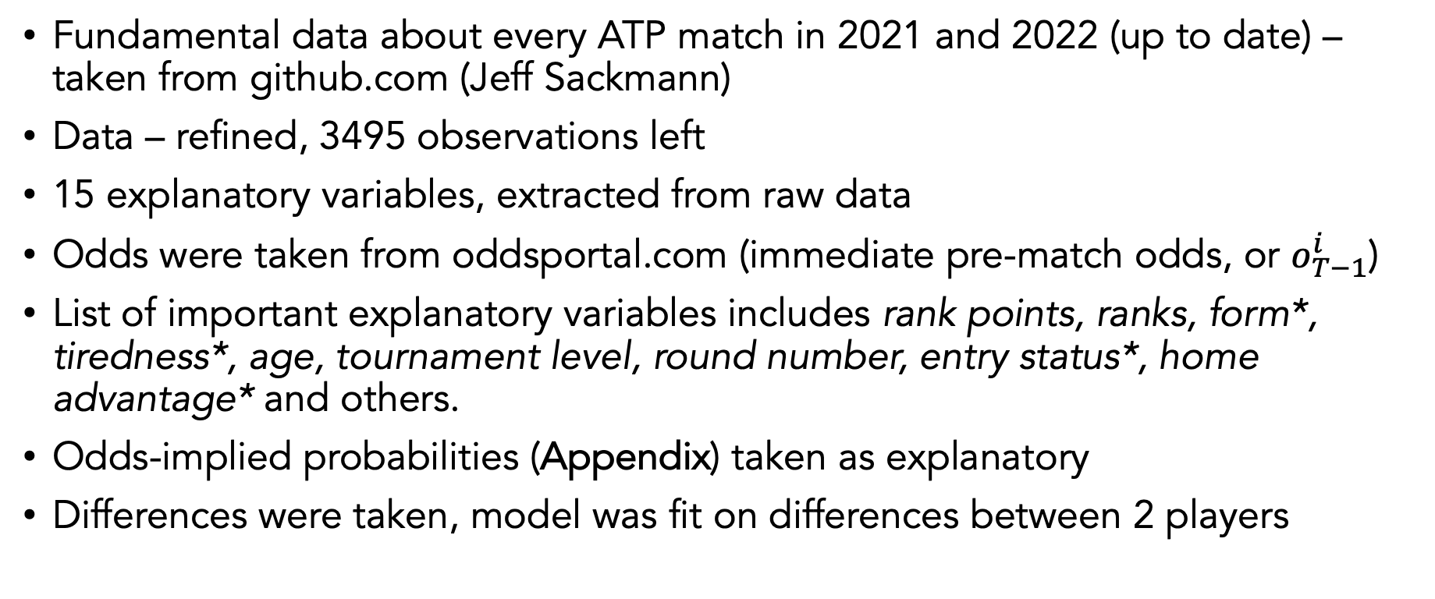
Dataset & Variables
Fundamental data about every ATP match in 2021 and 2022 (up to date) – taken from github.com (Jeff Sackmann)
Data – refined, 3495 observations left
15 explanatory variables, extracted from raw data
Odds were taken from oddsportal.com (immediate pre-match odds, or $o_{T−1}^{i}$)
List of important explanatory variables includes rank points, ranks, form*, tiredness*, age, tournament level, round number, entry status*, home advantage* and others.
Odds-implied probabilities (Appendix) taken as explanatory
Differences were taken, model was fit on differences between 2 players

Slide 7
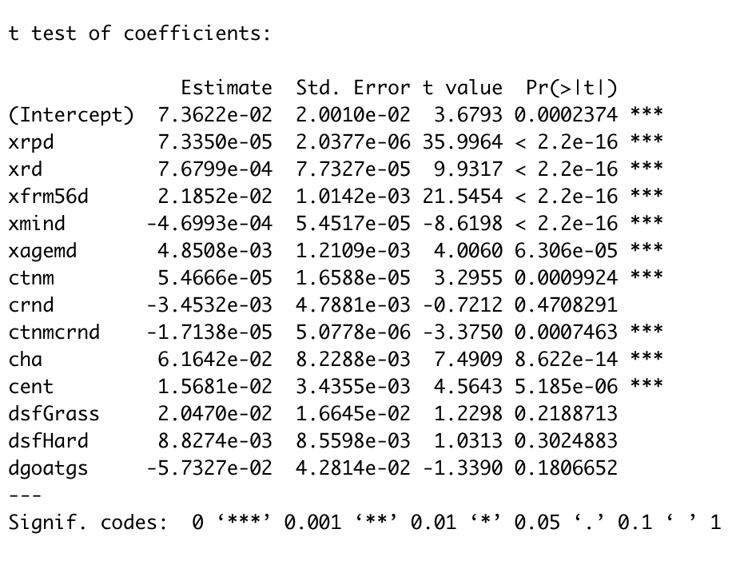
Estimation results
Odds-implied probability of win increase is associated with (keeping others fixed):
Higher ranking
Higher rank points
Better 2-month form
Lower level of tiredness within tournament
Higher deviation from average age
Home advantage
Higher entry status
Higher tournament level (with higher round within tournament offsetting the effect)
Model is jointly significant at 0.1% level
(Wald test)

Slide 8
Robustness check (w/ corrections [*])
*Multicollinearity was not detected (Appendix)
Heteroskedasticity was detected and accounted for (Appendix)
Model performs well on out-of-sample data based on p-value test (Appendix)
*Model performs well on out-of-sample data based on RMSE and MAE benchmarks (Appendix) [0.1939, 0.2076]; [0.1534, 0.1648]
Existence of omitted variables is possible

Slide 9
Conclusion
Very strong statistical evidence that several factors influence odds-implied probabilities individually
Strong statistical evidence that the model performs well in describing and predicting odds-implied probabilities
Model explains approximately 59.89% of variation in odds-implied probabilities
Betting odds reflect the available information to an extent
Outcomes:
Further research directions:
Searching for more complex factors (possible omitted variables)
Testing model performance on older data (consistency of bettors’ behavior over time)
Relating the results with match forecasting ability

Slide 10
Practical implications
Along track 1:
For betting companies – knowing the demand for pre-match odds given current initial
odds setting procedure
For bettors – finding perfect moment to bet, knowing both initial and pre-match odds
Along track 2:
Using the fundamentals from this model to forecast, and based on that, comparing
predicted probability of win with odds-implied one.
Finding perfect moment to bet, knowing both initial and pre-match odds + forecasted win
probability

Slide 11
Thank you for your attention!

Slide 12
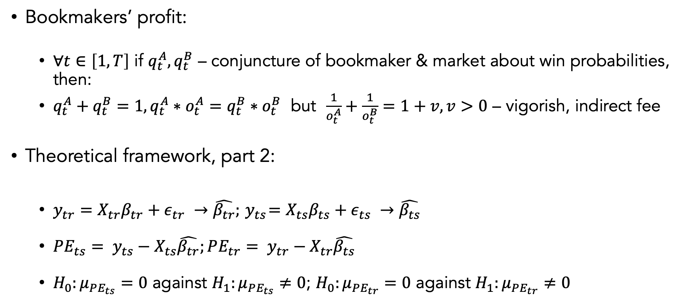
Appendix (1/5)
Bookmakers’ profit:
$∀t∈\left[1, T\right]$ if $q_{t}^{A}, q_{t}^{B}$ – conjuncture of bookmaker & market about win probabilities, then:
$q_{t}^{A}+q_{t}^{B}=1,q_{t}^{A}∗o_{t}^{A}=q_{t}^{B}∗o_{t}^{B}$ but $\frac{1}{o_{t}^{A}}+\frac{1}{o_{t}^{B}}=1+v,v>0$ – vigorish, indirect fee
Theoretical framework, part 2:
$y_{tr}=X_{tr}β_{tr}+ε_{tr} →\hat{β_{tr}};{ y}_{ts}=X_{ts}β_{ts}+ε_{ts} →\hat{β_{ts}}$
${PE_{ts}= y}_{ts}−X_{ts}\hat{β_{tr}};{PE_{tr}= y}_{tr}−X_{tr}\hat{β_{ts}}$
$H_{0}:μ_{PE_{ts}}=0$ against $H_{1}:μ_{PE_{ts}}≠0$; $H_{0}:μ_{PE_{tr}}=0$ against $H_{1}:μ_{PE_{tr}}≠0$

Slide 13

Appendix (2/5)
Odds-implied probabilities derivation
$\frac{1}{o_{w}}+\frac{1}{o_{l}}=1+v=>\frac{1}{o_{w}\left(1+v\right)}+\frac{1}{o_{l}\left(1+v\right)}=1=>$
$p_{w}=\frac{1}{o_{w}\left(1+v\right)}=\frac{1}{o_{w}\left(\frac{1}{q_{w}}+\frac{1}{q_{l}}\right)}=\frac{o_{l}}{o_{w}+o_{l}}; p_{l}=\frac{1}{o_{l}\left(1+v\right)}=\frac{1}{o_{l}\left(\frac{1}{o_{w}}+\frac{1}{o_{l}}\right)}=\frac{o_{w}}{o_{w}+o_{l}}$
$ypd=p_{w}−p_{l}=\frac{o_{l}−o_{w}}{o_{l}+o_{w}}$

Slide 14
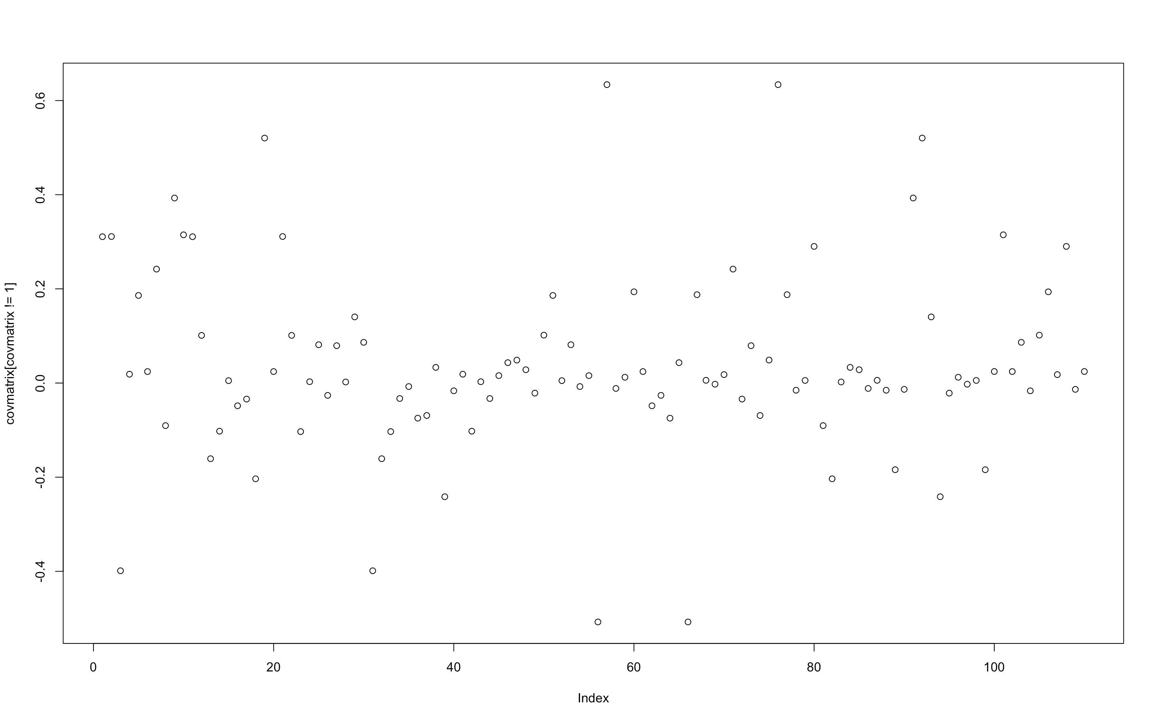
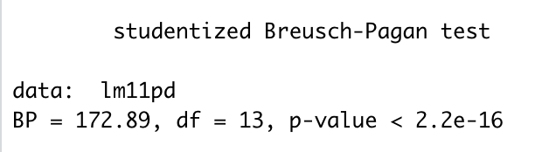
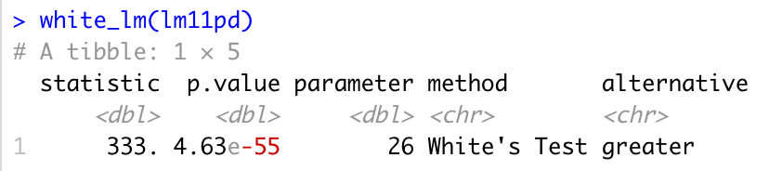
Appendix (3/5)
Correlations of explanatory variables
Results of Breusch-Pagan test (homoskedasticity hypothesis rejected)
0.6
-0.4
Results of White test (homoskedasticity hypothesis rejected)

Slide 15
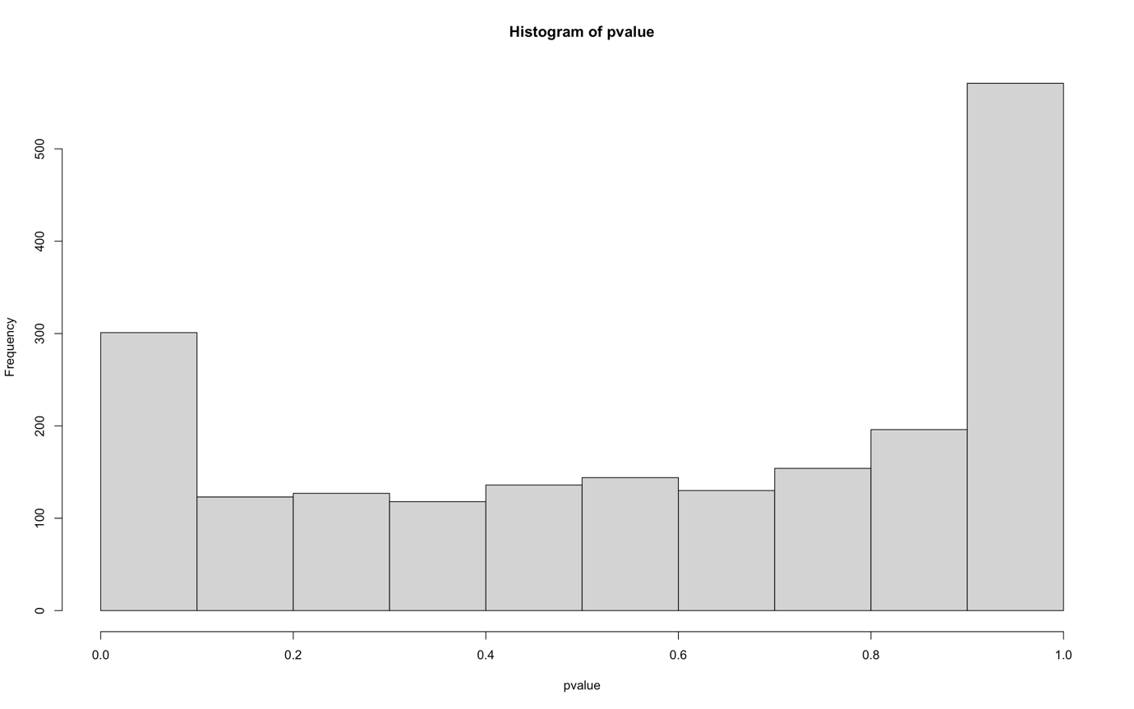
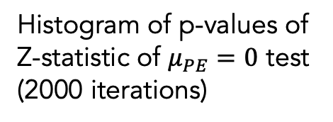
Appendix (4/5)
Histogram of p-values of Z-statistic of $μ_{PE}=0$ test
(2000 iterations)

Slide 16
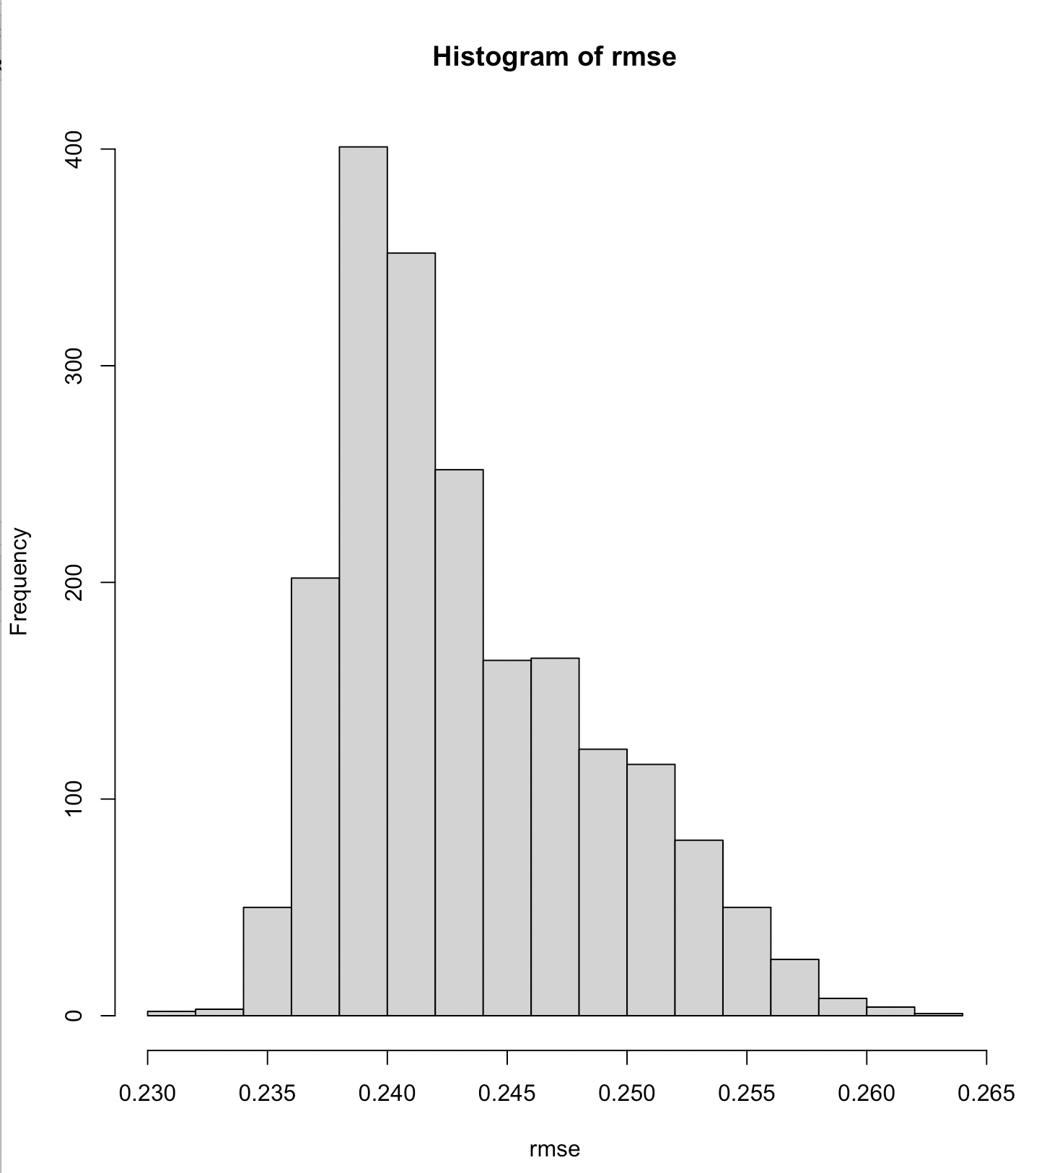
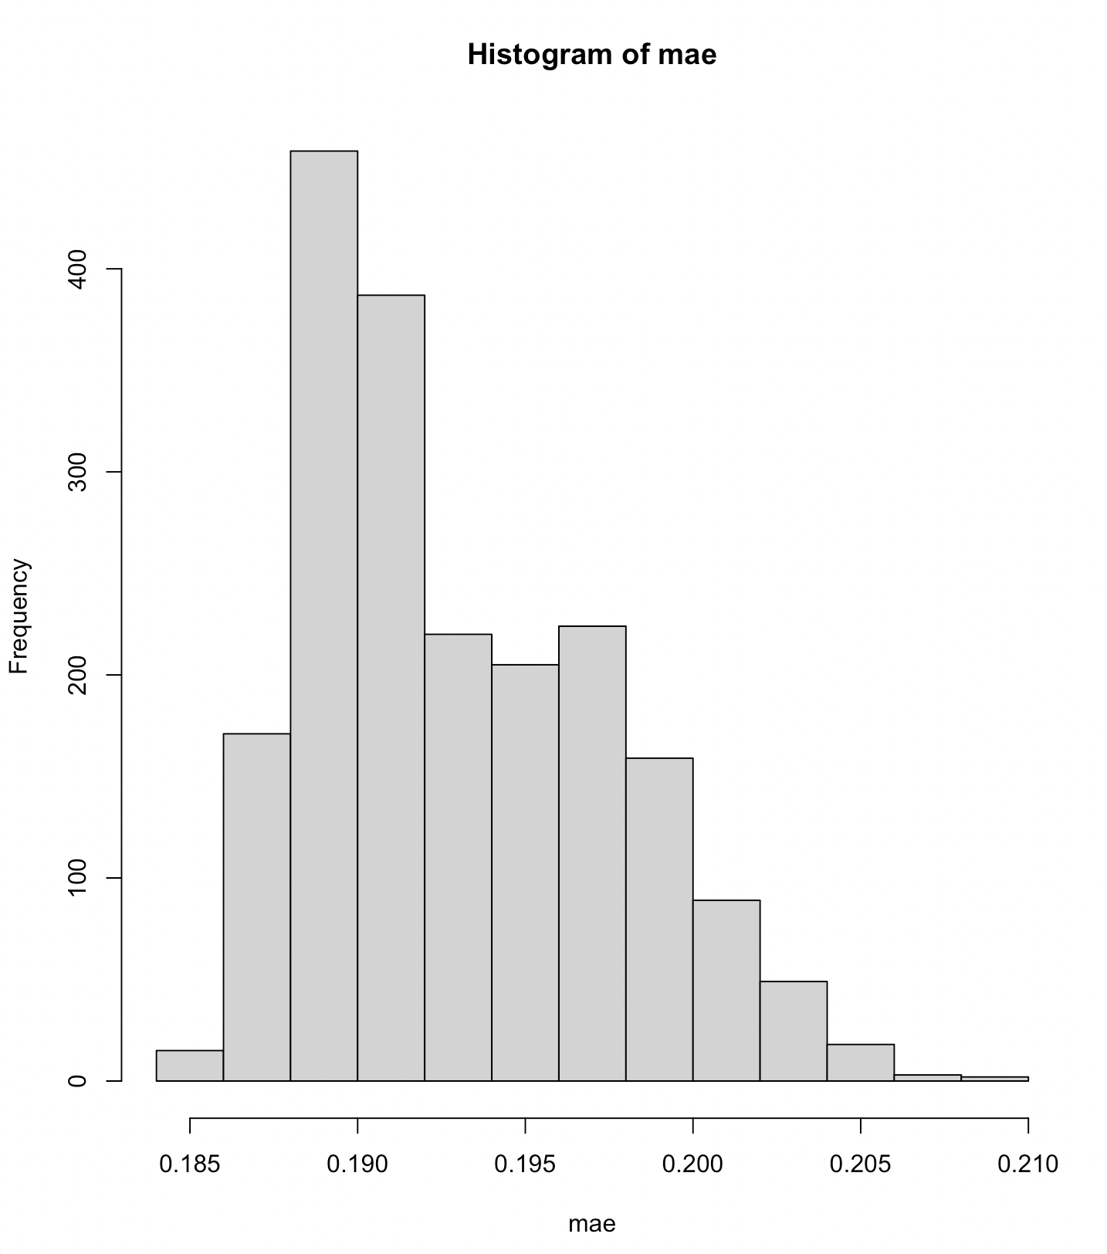

Appendix (5/5)
Histogram of RMSE
Histogram of MAE
Scale
RMSE 90%
[0.2368, 0.2536]
(to scale): [0.1939, 0.2076]
MAE 90%
[0.1874,0.2013]
(to scale): [0.1534, 0.1648]
Benchmark – 0.2

